Slide 1


Slide 2






GEORGIAN TAEKWON-DO
I.T.F FEDERATION
2014 wlis Sedegebi
www.tkd.ge
GEORGIAN TAEKWON-DO I.T.F. FEDERATION

Slide 3
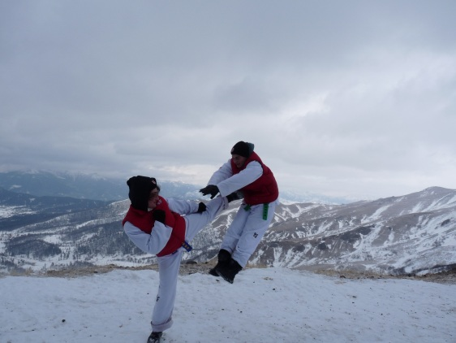
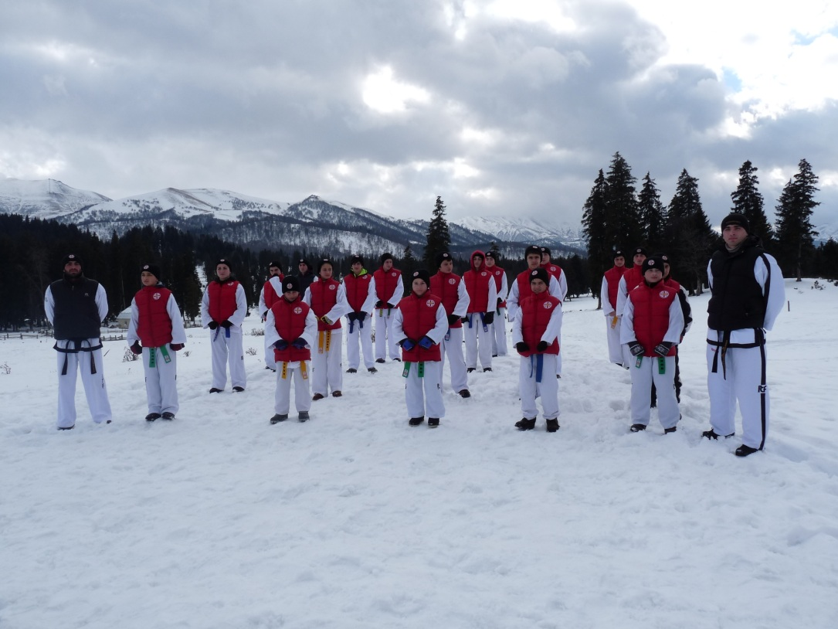
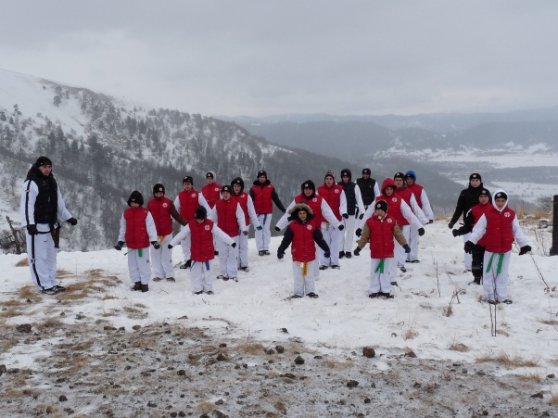
WINTER CAMP IN BAKURIANI
13-20th of January Winter meeting was held in Bakuriani where sportsmen from Tbilisi, Martvili and Poti were taking place.(22 in total)
They all had a preoperational training for to take a part in coming up national and international competitions.
Everyone who attended this seminar got a TKD printed hoodie, gloves and a mug
www.tkd.ge
GEORGIAN TAEKWON-DO I.T.F. FEDERATION

Slide 4
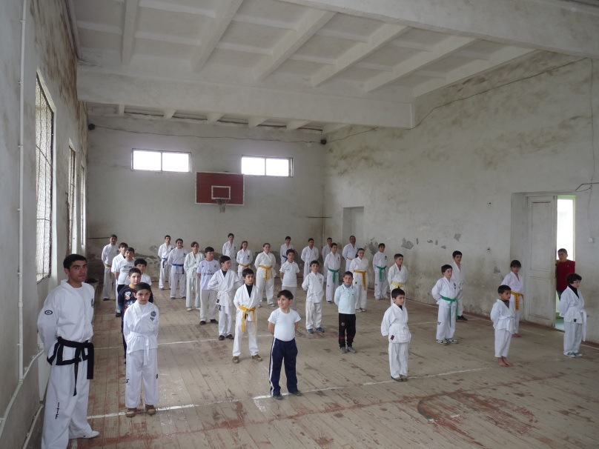
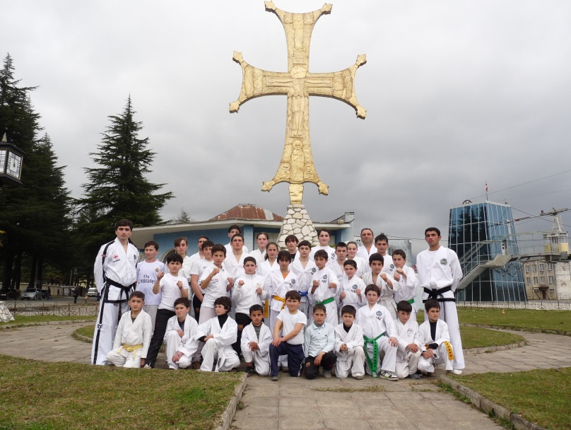
Seminar in Martvili
President of Georgian Taekwon-Do Federation, Mr Levan Tseretashvili holding an international coaching status run a seminar in Martvili where sportsmen from Lower Nagvzao and Martvili (35 all together) attended. After it they did a colour belt grading and successfully passed it.
We would like to thank Mr Irakli Tsulaia for everything he has done in Martvili Region for TaekwonDo
www.tkd.ge
GEORGIAN TAEKWON-DO I.T.F. FEDERATION

Slide 5
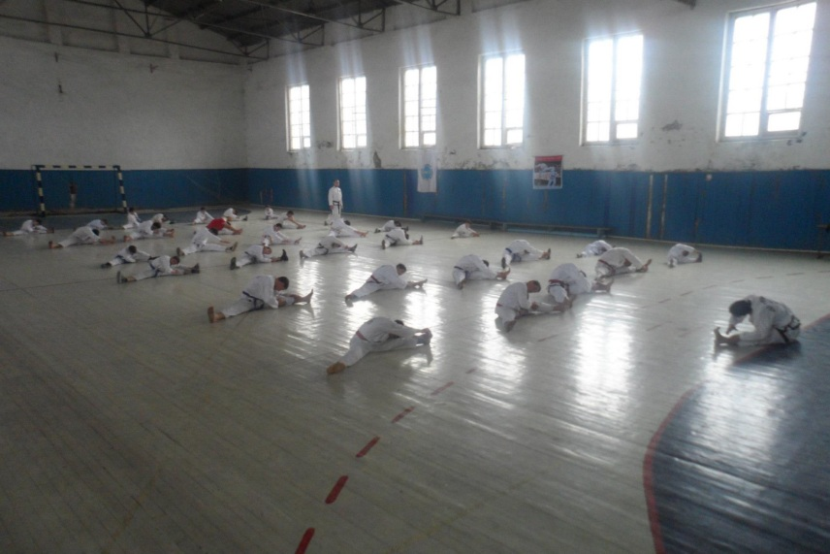
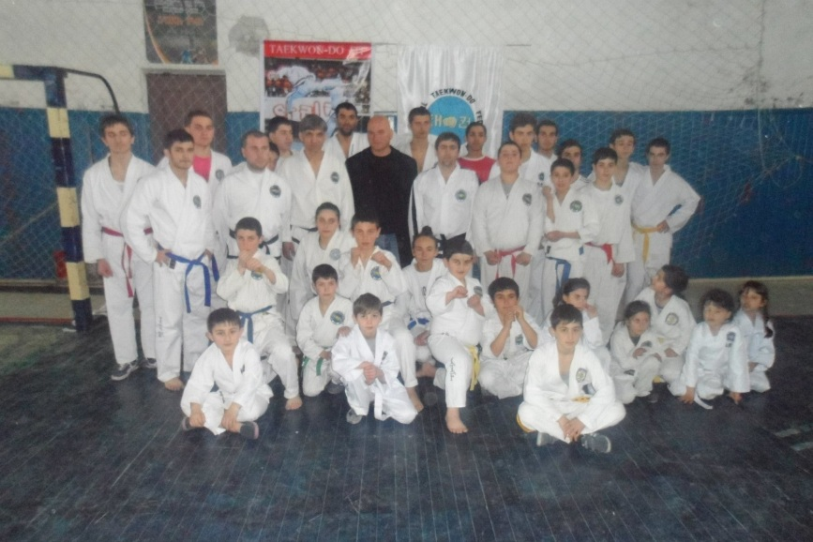
SEMINAR IN POTI
8th of march there was a joined training between students from Poti and Batumi where Coach
For Poti are Zaza Chanturia and Romeo Chikobava,for Batumi we had a pleasure to take a coach Paata Kumsiashvili.
www.tkd.ge
GEORGIAN TAEKWON-DO I.T.F. FEDERATION

Slide 6
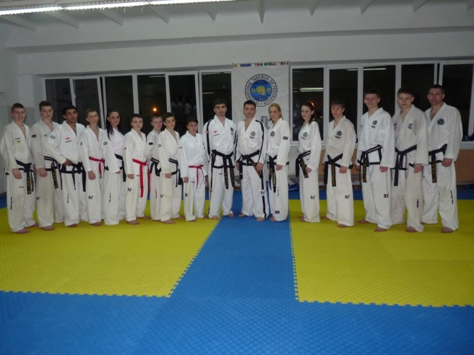
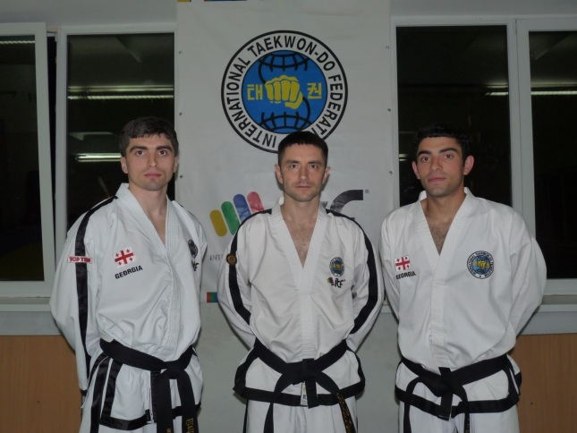
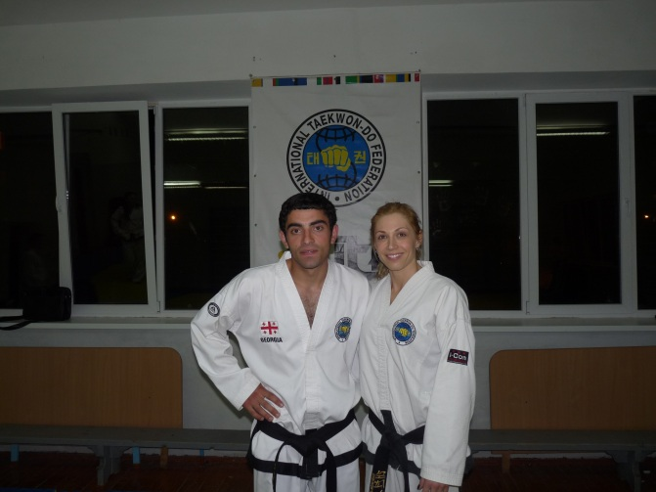
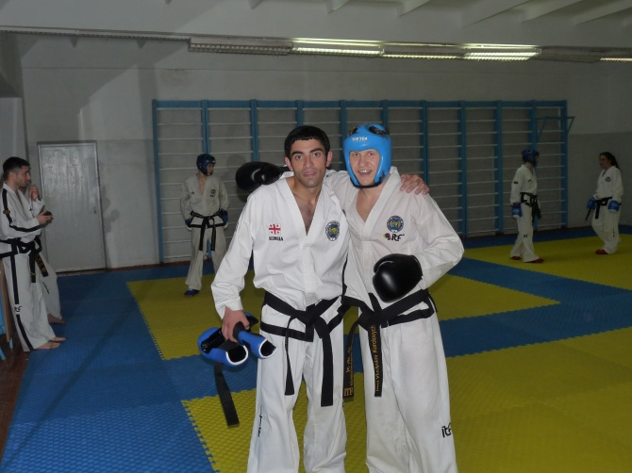
Sparing Seminar in Ukraine
20-25th of march a Sparing Seminar run by Oleg Solovey was held in city Ivano- Frankivsk, Ukraine, where Lvan Tsaretashvili and Irakli Tsulaia took a place.
The main reason to run this seminar was toget ready for European Cup which will be held in Italy on 24-27th of April.
We would like to take this opportunity and support all Ukraininans and wish them a success in Joining European Union.
GEORGIAN TAEKWON-DO I.T.F. FEDERATION
www.tkd.ge

Slide 7
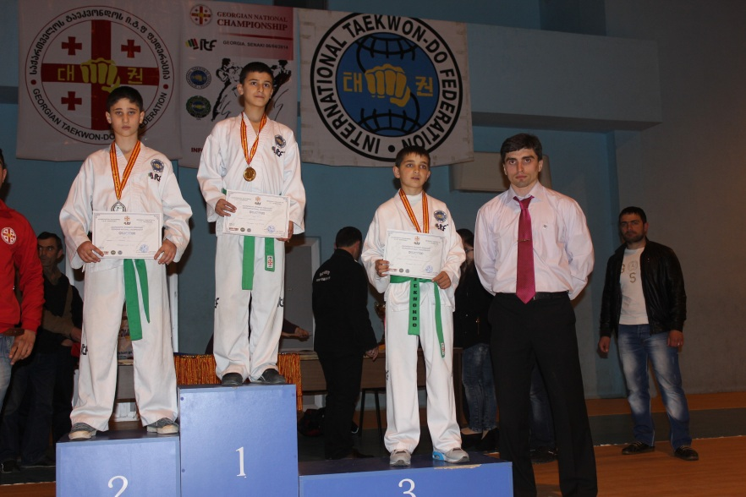
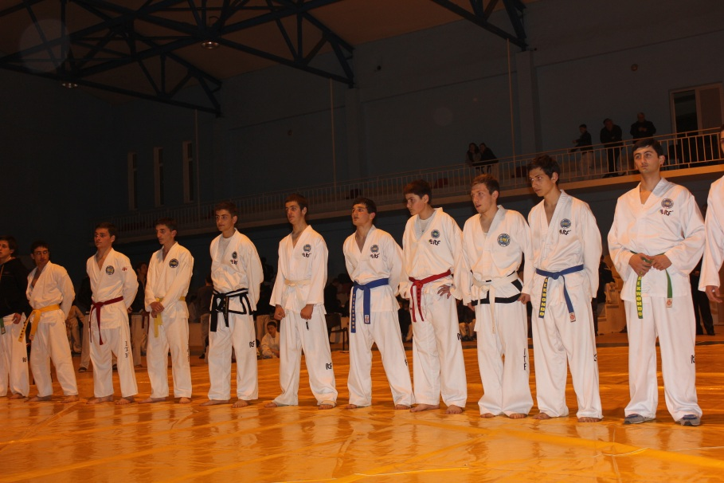

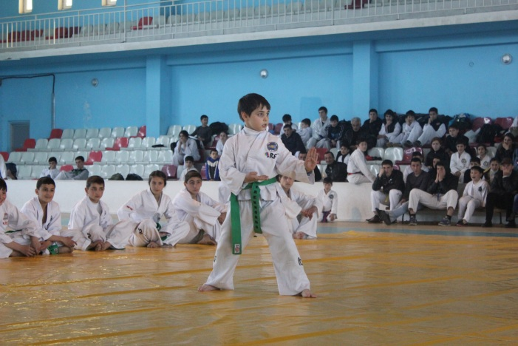
Georgian Open Championship
Georgian Open Championship was held on 6th of April in Senaki where students from Tbilisi,Kutaisi,Batumi and Poti were taking place.
Successful students will be taking place on European Challenge in Hungry in October
www.tkd.ge
GEORGIAN TAEKWON-DO I.T.F. FEDERATION

Slide 8
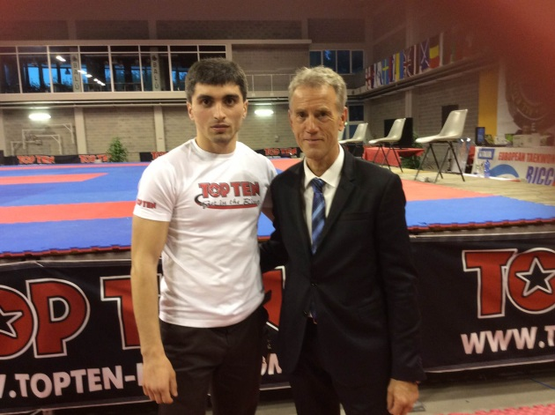
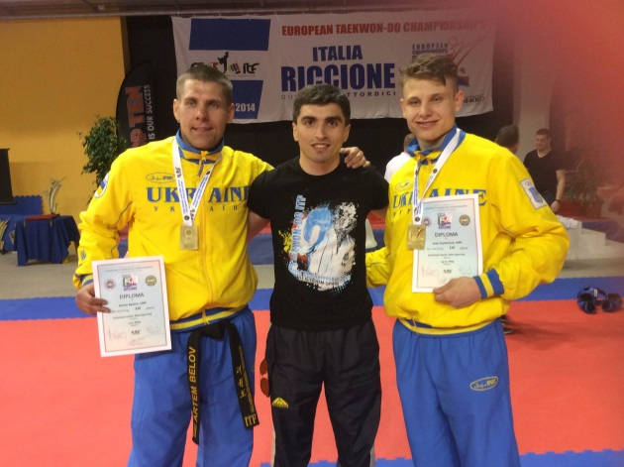
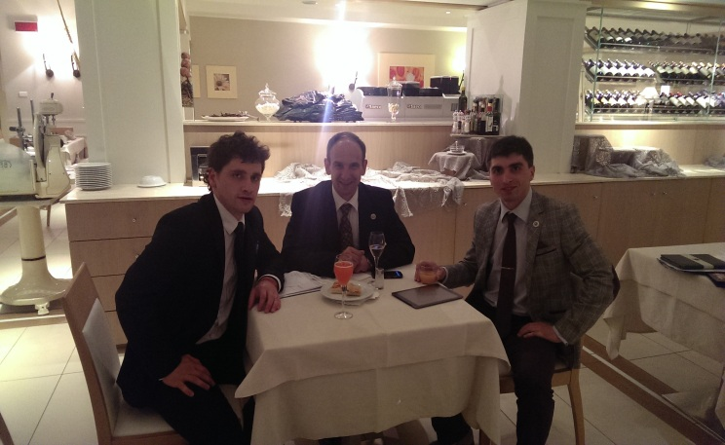
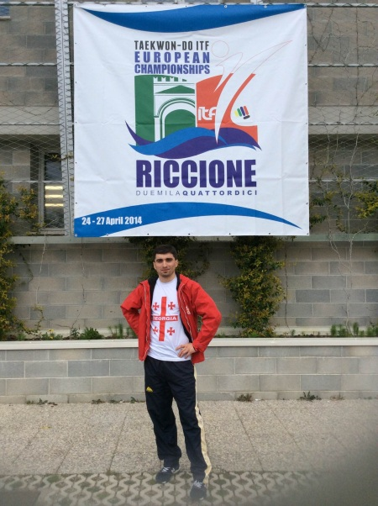
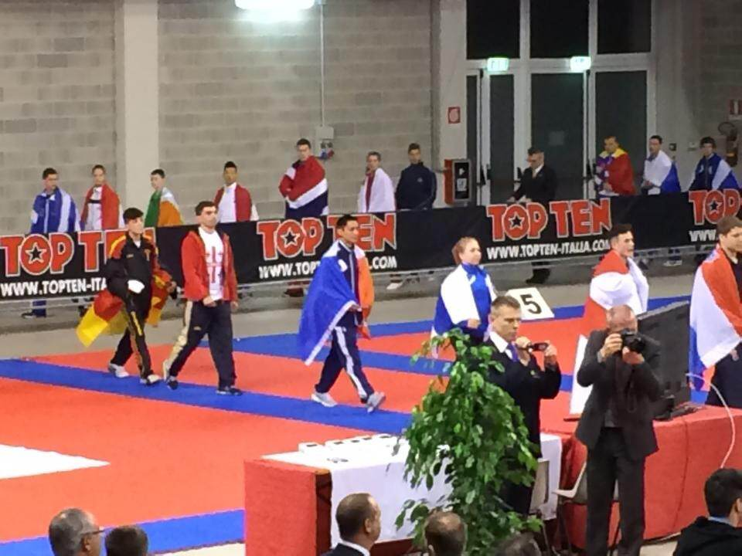
evropis Cempionati
City Ricione was the place where European Cup was hold on 24-27th of April.
There were around 600 competitors from 30 different countries.
After the competition was over an European TaekwonDo Congress took a place where Mr Levan Tsaretashvili was representing Georgia.
www.tkd.ge
GEORGIAN TAEKWON-DO I.T.F. FEDERATION

Slide 9
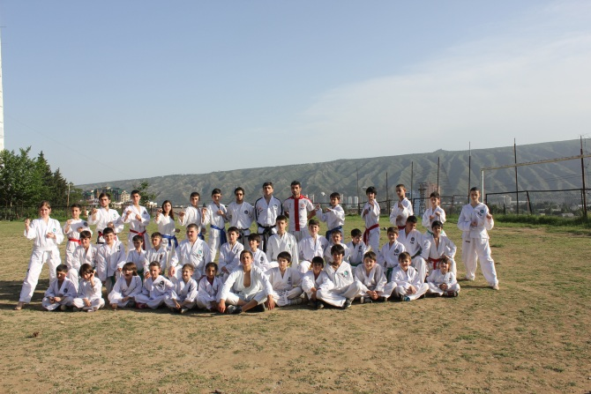
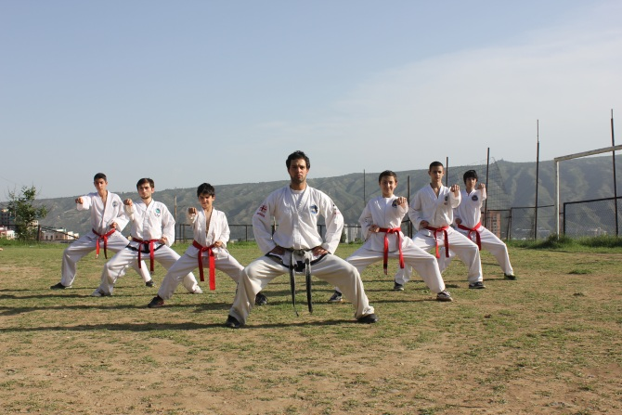
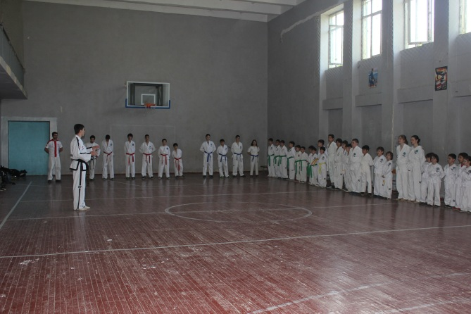
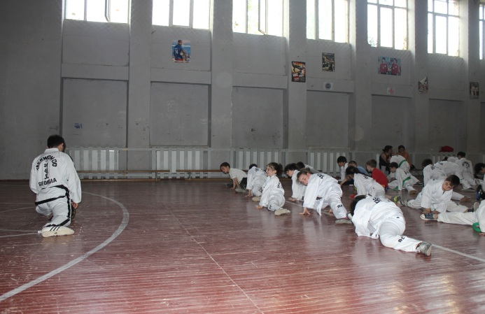
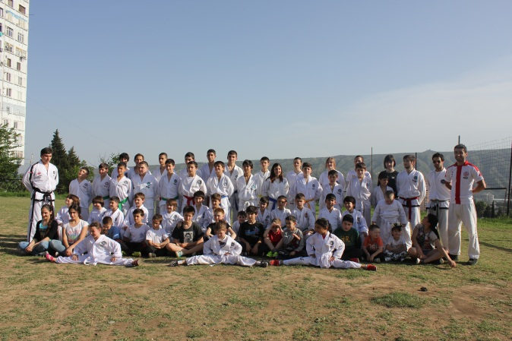

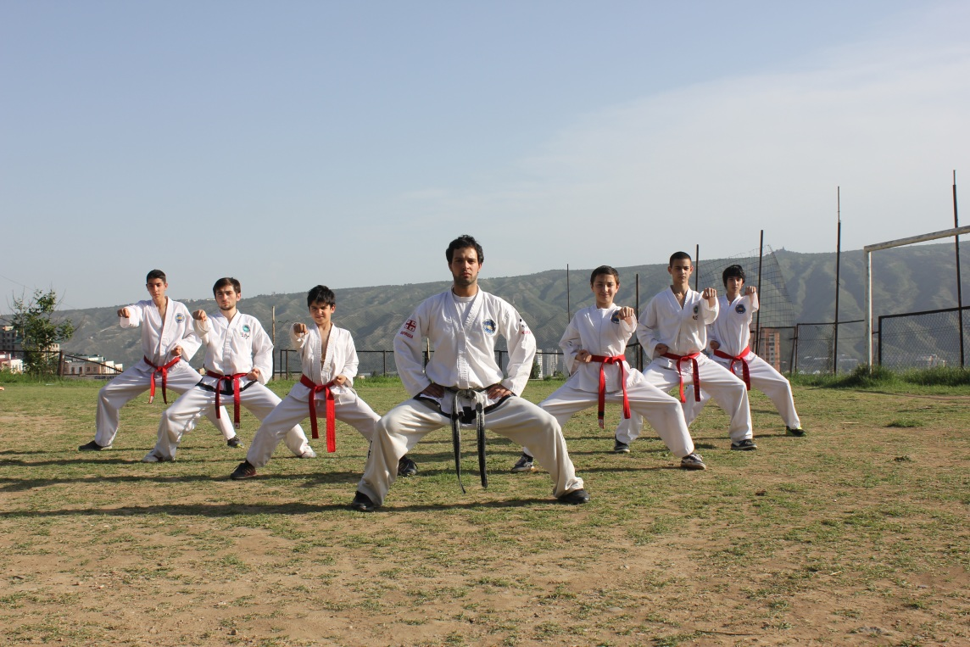

Seminar and Grading in Tbilisi
16th of May all the students from Tbilisi Taekwondo schools had a chance to take a part in a seminar and a grading after.
Around 70 students from 141nd ,90th ,31st and 136th passed a grading successfully.
www.tkd.ge
GEORGIAN TAEKWON-DO I.T.F. FEDERATION

Slide 10
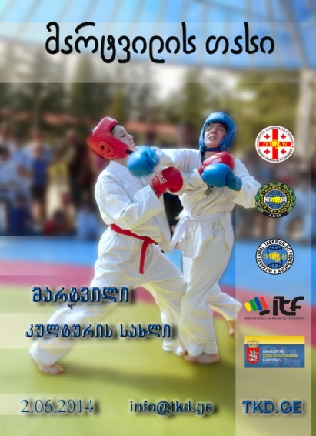
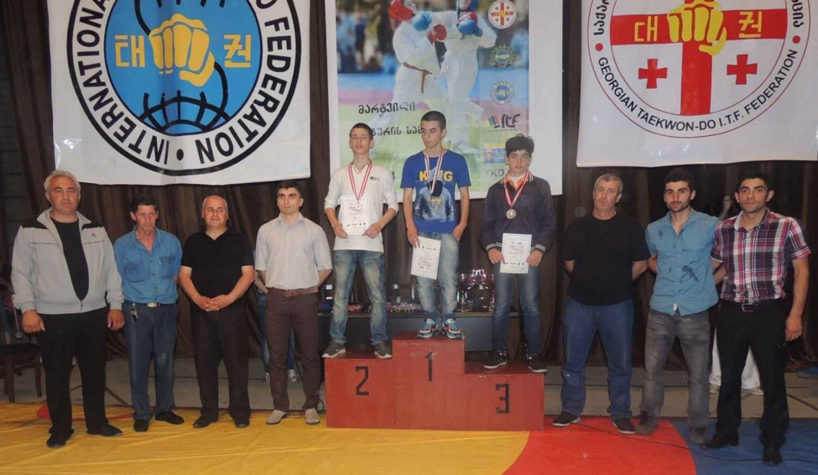
Cup of Martvil
Cup of Martvili was held on 2nd of Jun 2014 where 84 students from different Regions of Georgia had a chance to take a place.
It was the 3rd time we run this cup and we are hoping that we will be running it annually as this given club exists only 3 years and it indeed is one of the biggest clubs in Georgia.
We would like to take a chance to thank a head coach of Martvili Mr Irakli Tsulaia who did everything in order to go ahead and to be more successful.
We would like to thank to Martvili Sport School and Board of Government for supporting every sports event held in Martvili.
www.tkd.ge
GEORGIAN TAEKWON-DO I.T.F. FEDERATION

Slide 11
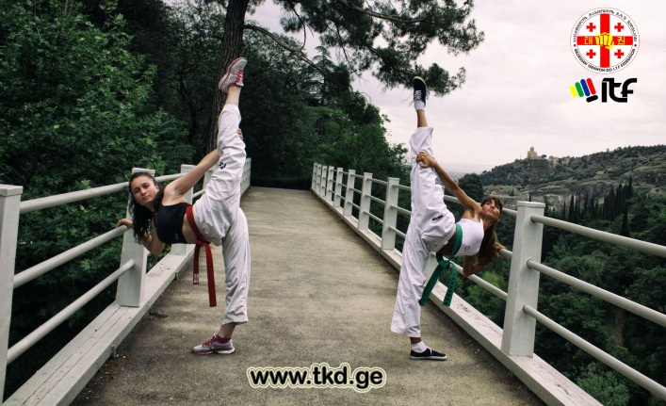
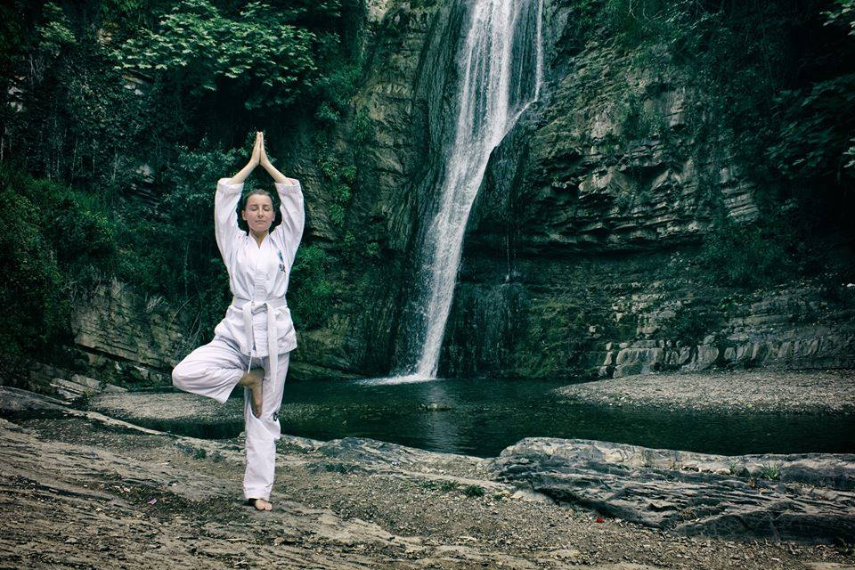
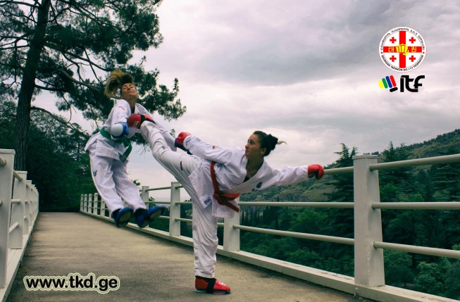
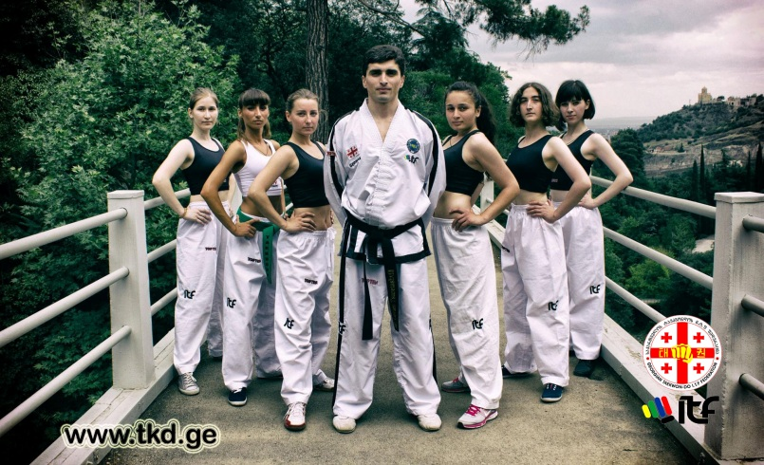
Taekwon-Do for Girls
20th of June, Photo shoot was held in one of the botanical gardens where Advanced and beginner female taekwondo students were taking place.
We are actively trying to get more female students in taekwondo and offering them a special training Programme to match their needs.
GEORGIAN TAEKWON-DO I.T.F. FEDERATION
www.tkd.ge

Slide 12
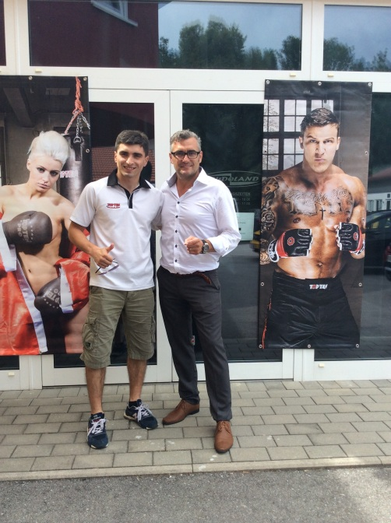
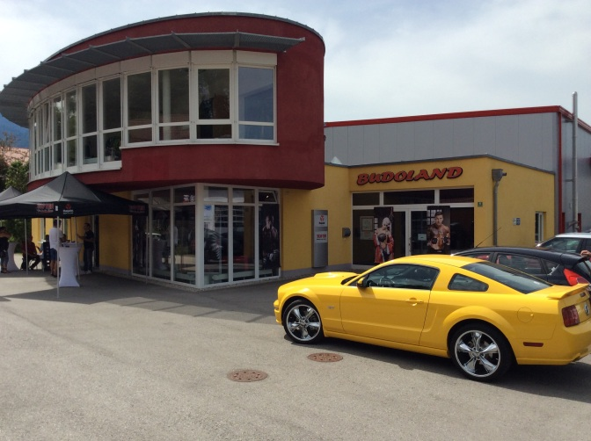


Meeting in Budoland
3rd of July, Germany was the place where Budoland(sports inventory brand and shop) had a meeting for its distributors.
This is an organization which unifies several sport organization and it is one of the biggest on European Market.
It also is an official sponsor for World TaekwonDo Federation, Karate, Kickboxing, Boxing and Mixed Martial Arts.
Levan Tsaretashvili is the representative of Budoland in Georgia
www.tkd.ge
GEORGIAN TAEKWON-DO I.T.F. FEDERATION

Slide 13
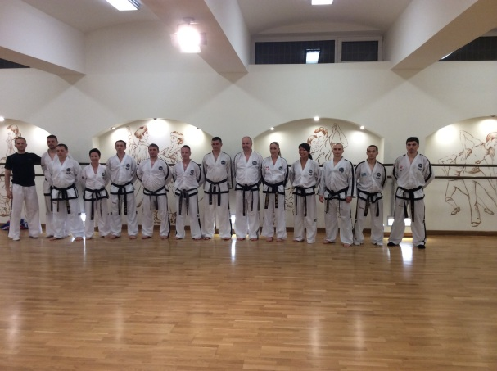
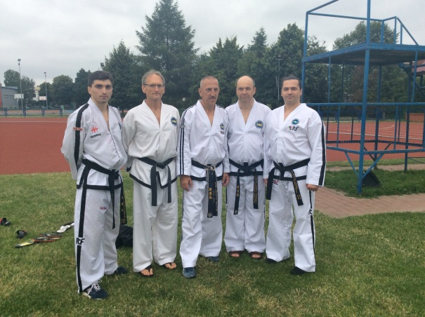
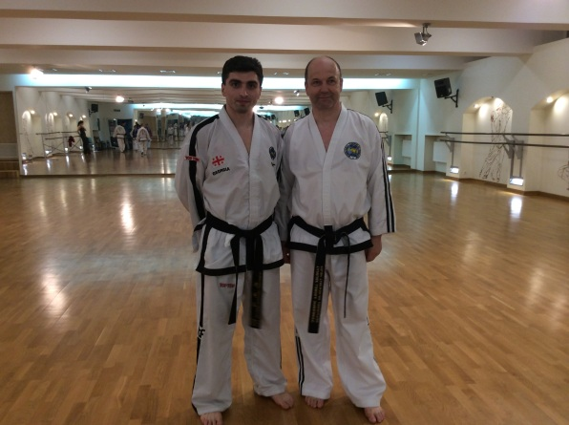
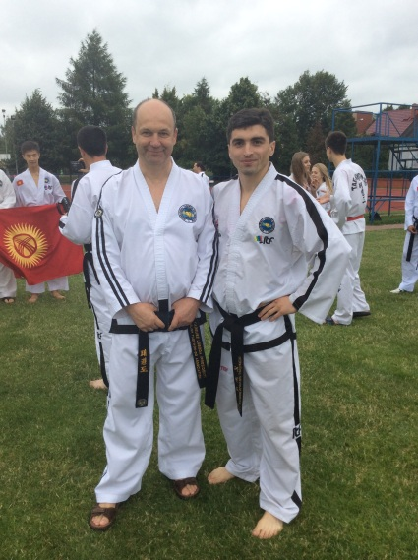
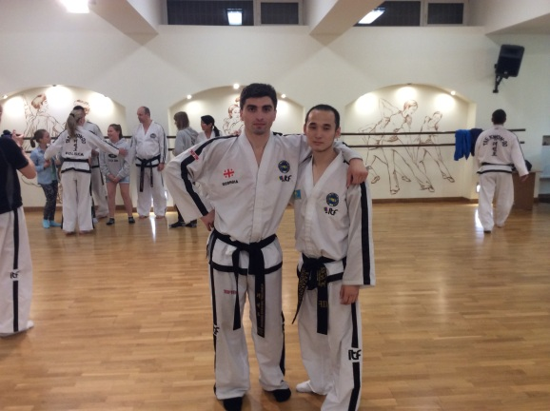
Summer camp in Poland
On 4-13th of July,City Biala Podlaska,Poland was the Host of European Summer Camp where representatives from 15 different countries were taking places.
Among them was Mr Levan Tsaretashvili too who was representing Georgia.
www.tkd.ge
GEORGIAN TAEKWON-DO I.T.F. FEDERATION

Slide 14
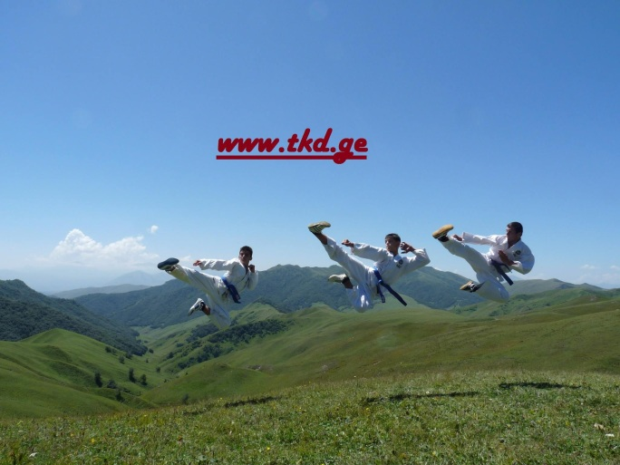
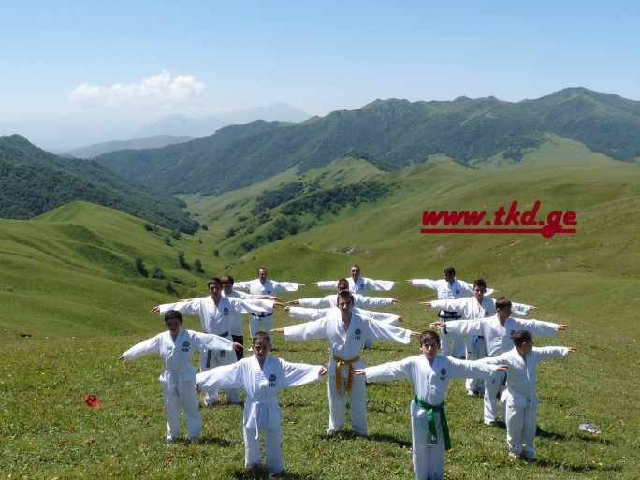
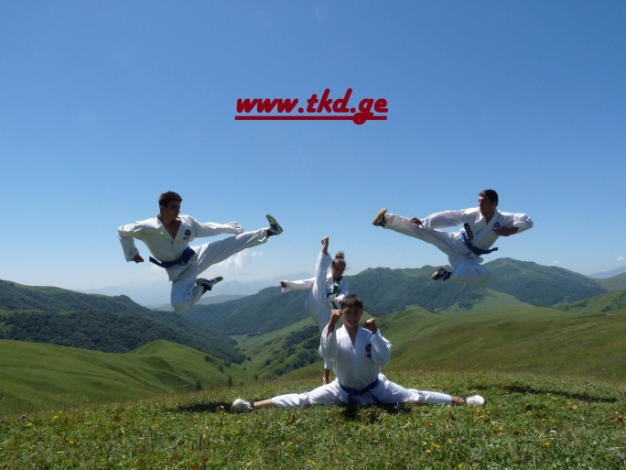
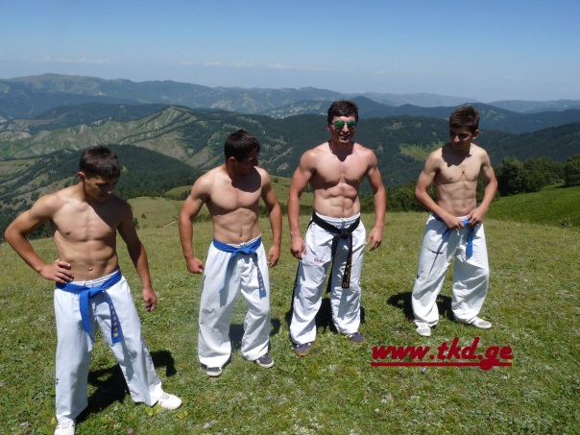
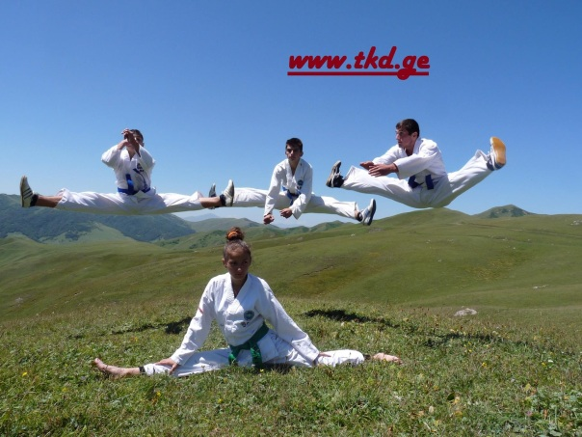
Summer camp in Georgia
20th of July to 8th of August we had a Summer Camp in Ateni Ravine. Students were training to build their confidence and skills.
This was the 6th summer camp and we are hoping that this event will take an annual face.
www.tkd.ge
GEORGIAN TAEKWON-DO I.T.F. FEDERATION

Slide 15
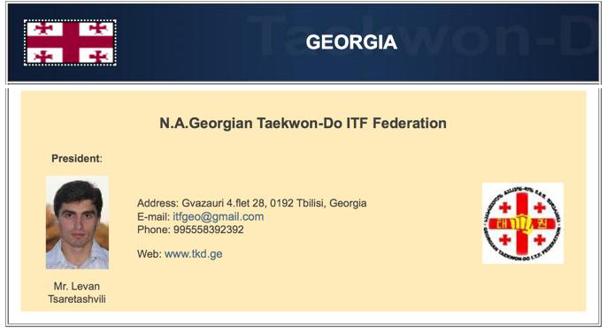
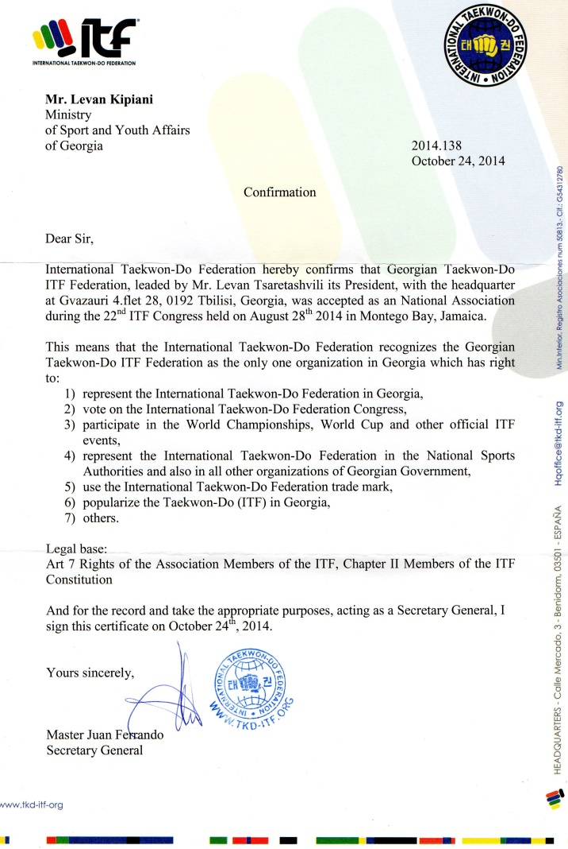
N.A Status
World Cup was held on 26-30th of August 2014 Jamaica after which an international Congress took a place.
There was a discussion about what was happening in Georgian Taekwon-Do Federation and about our achievements. As there were 2 TKD Organisations registered in Georgia there always was a big confusion by it and it was causing a number of difficulties.
By unanimous decision Mr Levan Tsaretashvili was Promoted as a President of Georgian ITF Taekwon-Do Federation. From now on only students registered with Georgian ITF federation are allowed to take a part in international competitions.
www.tkd.ge
GEORGIAN TAEKWON-DO I.T.F. FEDERATION

Slide 16
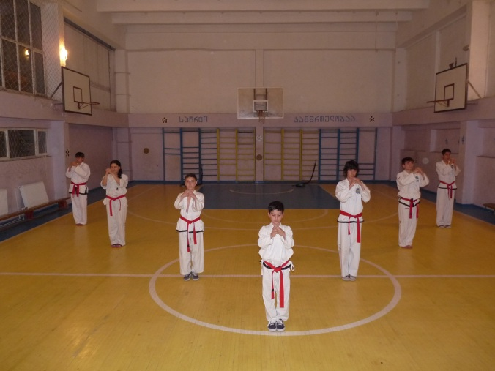
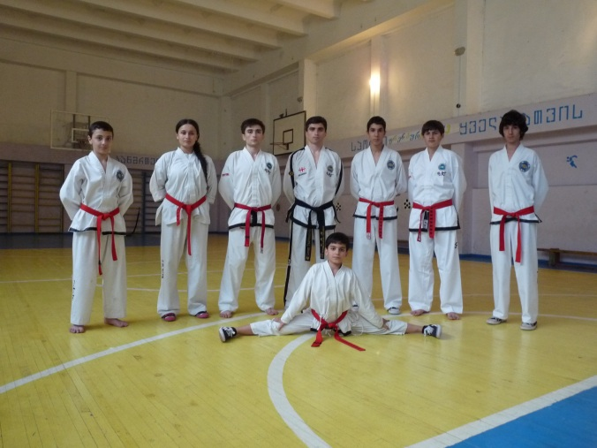
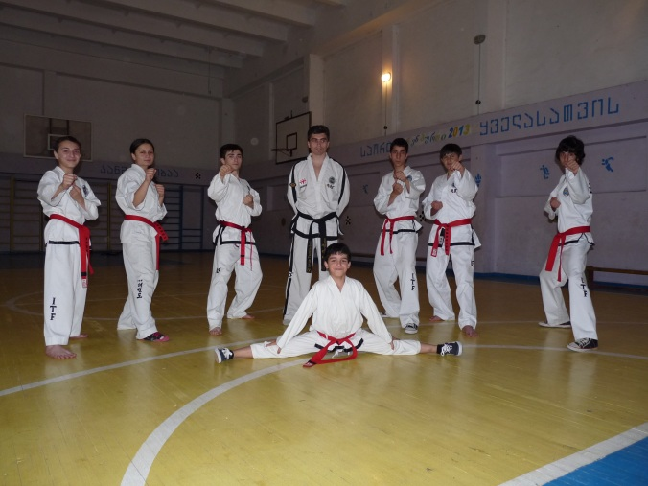
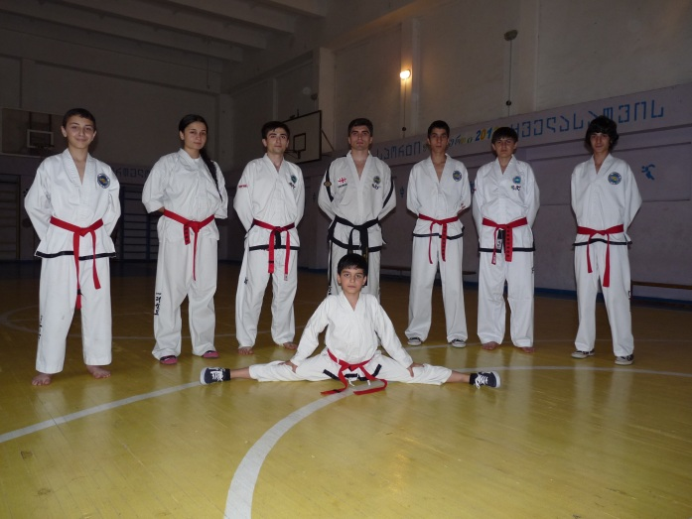
Black Belt Grading
First Ever black belt grading was held in Georgia in 2014. There were 12 students grading for 1st Dan, 3 grading for 2nd Dan and 12 students got a license to be an Umpire/Coach on international competitions.
www.tkd.ge
GEORGIAN TAEKWON-DO I.T.F. FEDERATION

Slide 17
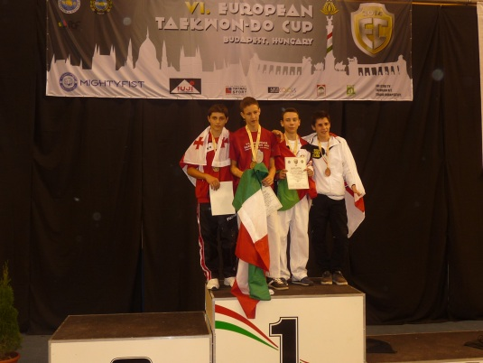





European Cup
European Cup on 10-12th of October was successful for Georgian Competitors where Genrid Tsakhnakia took a Bronze and Otar Tsotsonava took a silver in -56kg.
www.tkd.ge
GEORGIAN TAEKWON-DO I.T.F. FEDERATION

Slide 18



Senaki Open
Senaki Open was held in Senaki on8th of November where 70 Junior and Senior competitors were taking place.
There were 13 weight categories in it.
We would like to thank to Senaki Sports Union for all the support shown.
Martvili Team took a first place as a team by taking 5 gold medals.

Slide 19




Cup of Asia 2014
City Almaty was the host Cup of Asia where 19-20th of November Otar Tsotsonava took a 3rd place and Levan Tsaretashvili took a gold medal.
This competition is very popular in Kazakhstan and it has been broadcasted on TV.

Slide 20




Master Mazovia Cup
21-22nd of November city Ciechanow was the host of the Mazovias Cup where competitors from Georgia taking part, this was the third time our competitors were successfully taking part in it.
Out of 5 competitors nana Putkaradze and Ivane Kokaia took 2 bronze medals. We also had an unlucky competitor Valeri Kekua who was very close to a medal but he got a bad injury.
We would like to thank Mr Zaza Lemonjava for escorting our competitors to Poland.

Slide 21


Slide 22




We would also like to thank Mr Otar Mgeliashvili who came back to Georgia from Ireland who has been training and studying there for 10 years.
He is the most successful Georgian sportsman who has been taking part on international competitions. He has won Irish cup 6 times, European challenge 2 times and many other competitions.

Slide 23
This year was very successful for our federation, I would like to highlight few main events.
1, We were granted to have a name of an international federation. This gives us an opportunity to go abroad ,complete there and to be named as a sports organization.
2. First in our federation history we held a black belt grading, 3 students were granted by 3rd Dan and 12 were granted by 1^{st,} . there were also given 12 instructor certificates.
3. We have opened 2 more regions in Georgia which are Tsalenjikha and Abasha. So far we have schools in 9 Regions in Georgia.
And this is not the end. We are going ahead and improving everything we can.

